Slide 1
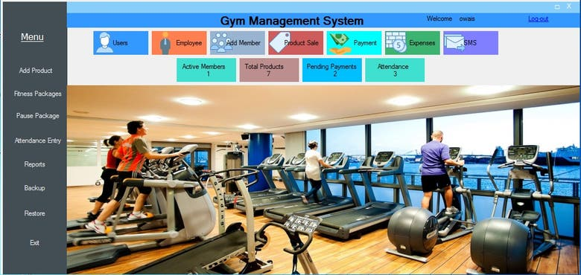
Title: Gym Management System: C++ Programming
Presented by
K. Madhusudhan(192210035)
D. akash(192210443)

Slide 2

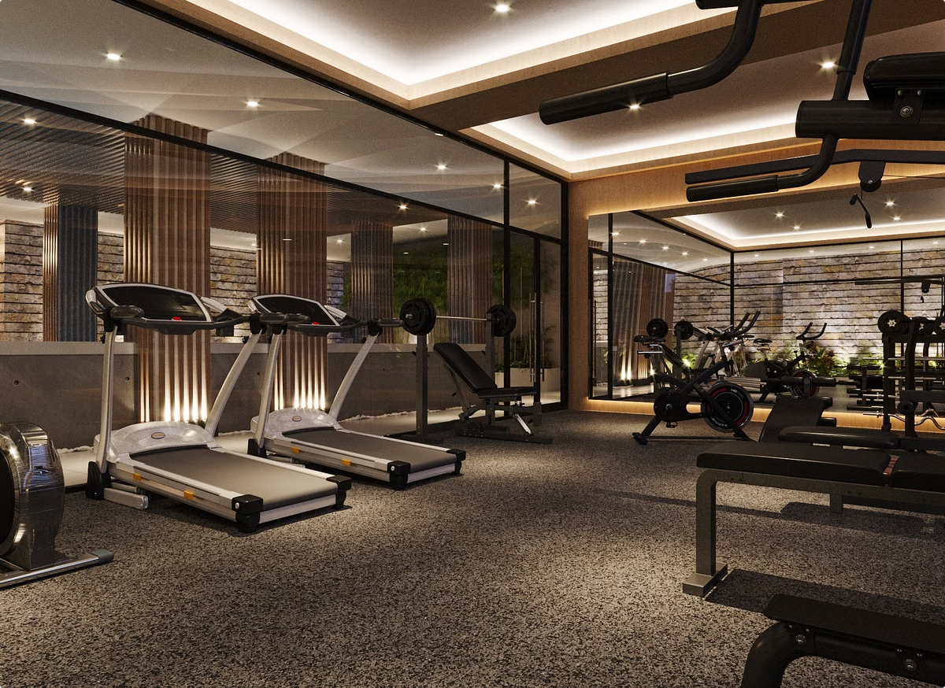
Gym Management System: C++ Programming
This presentation will outline the development of a comprehensive gym management system using the C++ programming language. The system aims to streamline gym operations, enhance member experiences, and provide valuable data for management.

Slide 3

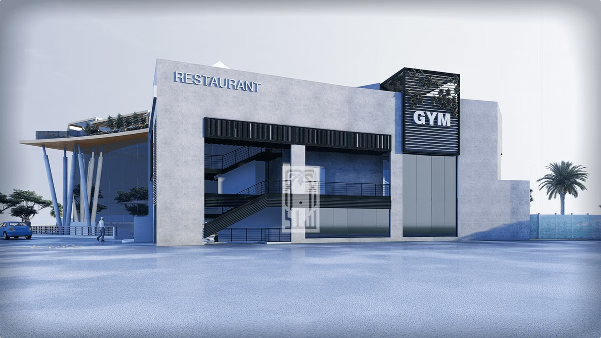
Introduction to the Gym Management System
The gym management system is designed to address the unique needs of modern gyms, providing a centralized platform for managing members, scheduling workouts, tracking progress, and more. This system leverages the power of C++ to ensure efficiency, scalability, and robust functionality.
Membership Management
Workout Planning
The system enables seamless member registration, tracking of membership details, and management of subscriptions.
Members can access personalized workout plans, track their progress, and schedule appointments with trainers.
Equipment Management
Reporting and Analytics
The system allows for inventory tracking, maintenance scheduling, and efficient allocation of equipment.
The system provides valuable insights into gym usage patterns, member preferences, and financial performance.

Slide 4
Key Features of the System
The gym management system offers a range of essential features designed to optimize gym operations and enhance member engagement.
Member Management
Workout Scheduling
Equipment Management
Register new members, manage their profiles, track membership details, and generate membership reports.
Create personalized workout plans, schedule appointments with trainers, and track member progress.
Maintain an inventory of equipment, schedule maintenance, and track equipment usage.

Slide 5

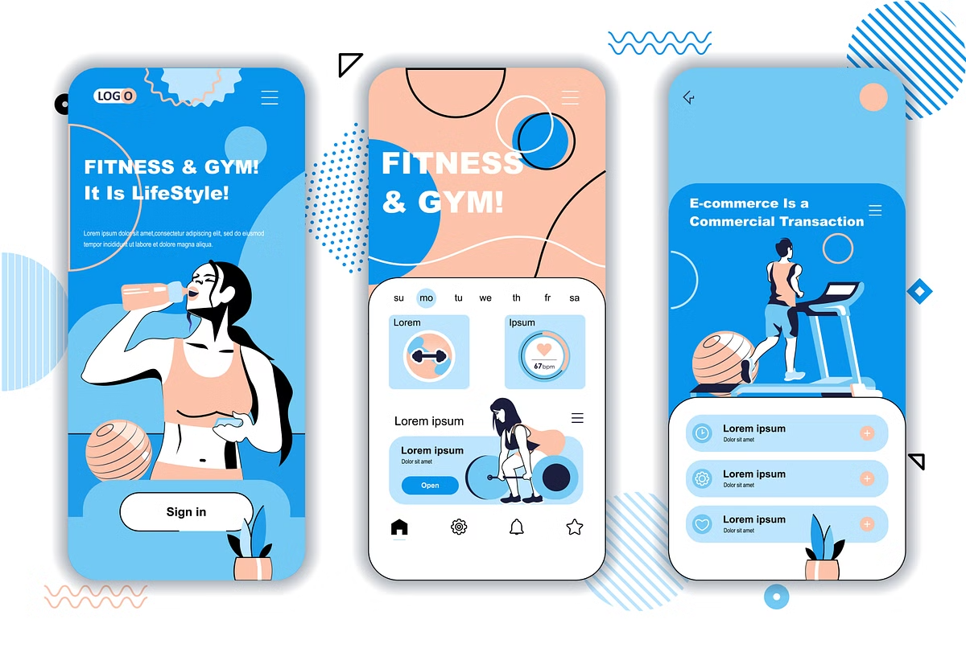



User Interface and Functionality
The system features a user-friendly interface designed to be intuitive for both gym staff and members. It allows for easy navigation, efficient data entry, and quick access to essential information.
Member Login
Members can log in to access their personalized profiles, workout plans, and progress reports.
Staff Dashboard
Gym staff can access a dashboard with comprehensive insights into gym operations, member data, and financial performance.
Equipment Management
Staff can manage equipment inventory, schedule maintenance, and track equipment availability.

Slide 6


Member Registration and Tracking
The system enables efficient member registration, providing a comprehensive platform for tracking member details, membership status, and other essential information.
1
Member Profiles
2
Membership Tracking
Members can create profiles with personal information, fitness goals, and emergency contact details.
The system automatically tracks membership start dates, renewal dates, and payment history.
3
Membership Types
4
Communication Tools
The system supports various membership types, including monthly, annual, and student memberships.
Members can receive email or SMS notifications for membership updates, upcoming appointments, and gym announcements.

Slide 7

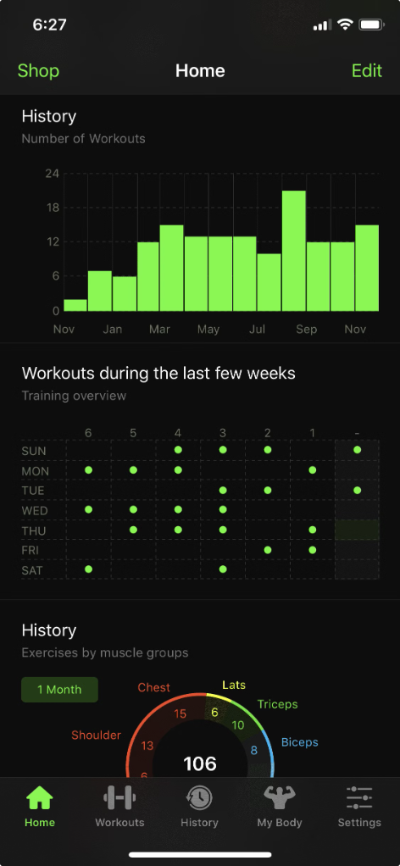
Workout Scheduling and Monitoring
The system allows members to schedule personalized workouts, track their progress, and access a comprehensive library of exercises.
1
Workout Plan Creation
Members can work with trainers to create tailored workout plans based on their fitness goals and preferences.
2
Workout Scheduling
Members can schedule individual workouts, group classes, and appointments with trainers.
3
Progress Tracking
Members can track their progress through detailed workout logs, weightlifting records, and fitness assessments.
4
Exercise Library
Members can access a library of exercises with video demonstrations and detailed descriptions.

Slide 8


Inventory and Equipment Management
The system simplifies equipment management, providing a centralized platform for tracking inventory, scheduling maintenance, and allocating equipment.
Feature
Description
Inventory Tracking
Comprehensive inventory management system for all gym equipment.
Maintenance Scheduling
Schedule regular maintenance for equipment and track repair history.
Equipment Allocation
Track equipment usage and ensure efficient allocation to members and trainers.

Slide 9

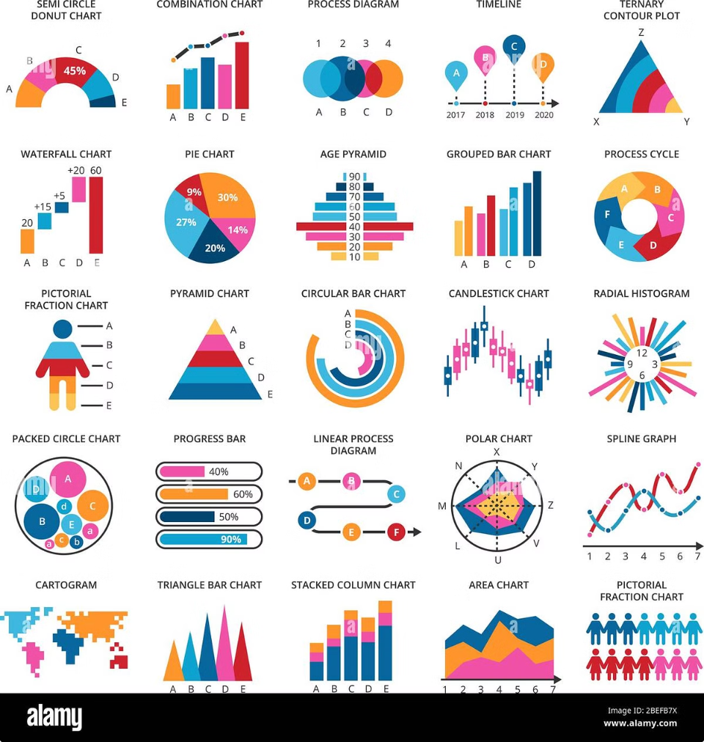




Reporting and Analytics
The system provides comprehensive reporting and analytics capabilities, enabling gym management to gain valuable insights into gym operations, member behavior, and financial performance.
Membership Statistics
Workout Activity
Track key membership metrics such as enrollment rates, renewals, and churn.
Analyze workout patterns, popular exercise types, and member engagement.
Financial Performance
Member Engagement
Monitor revenue, expenses, and profitability to optimize gym operations.
Identify trends in member activity, class participation, and trainer interaction.

Slide 10


Security and Access Control
The system incorporates robust security measures to protect sensitive data, ensuring secure access and data integrity.
1
User Authentication
2
Data Encryption
Secure login credentials and multi-factor authentication for members and staff.
Encryption of sensitive member information and financial data.
3
Access Control
4
Regular Security Audits
Role-based access control to restrict access to specific features and data.
Regular security audits to identify and mitigate potential vulnerabilities.

Slide 11


Scalability and Maintenance
The gym management system is designed for scalability, allowing for future expansion to accommodate growing member bases and evolving features.
Scalability
Maintenance
The system can be easily scaled to handle a larger number of members, equipment, and staff.
Regular updates and bug fixes ensure the system remains secure and functional.

Slide 12
Pseudocode for Gym Management System:
Initialize System
Main Menu Options
Register New Member
View Member Details
Manage Equipment
Track Schedules
Process Payments
Exit System

Slide 13
THANK YOU !

